Slide 1

Amazon
Aanya Bhaskar

Slide 2
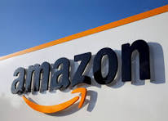

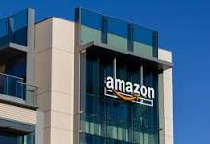
History of Amazon
Jeff Bezos started Amazon
Amazon was a bookstore
1994
Created in Bellevue, Washington

Slide 3
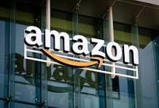

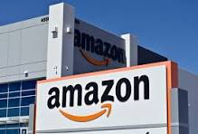
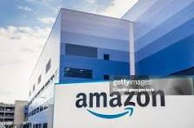
What is Amazon’s industry?
Online shopping
Things that are in store

Slide 4
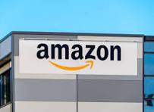
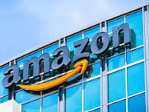
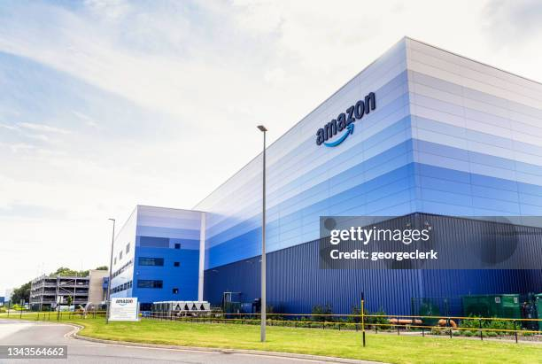
Is the Corporation publicly traded?
Yes, it is
One share is $230.32

Slide 5
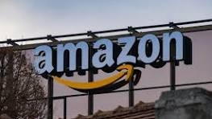
Is Amazon producing revenue?
Yes
Amazon is a massive company
In 2021, the revenue was $469.82 billion

